Slide 1

Chapter 7 Wavelets and Multiresolution Processing

Slide 2
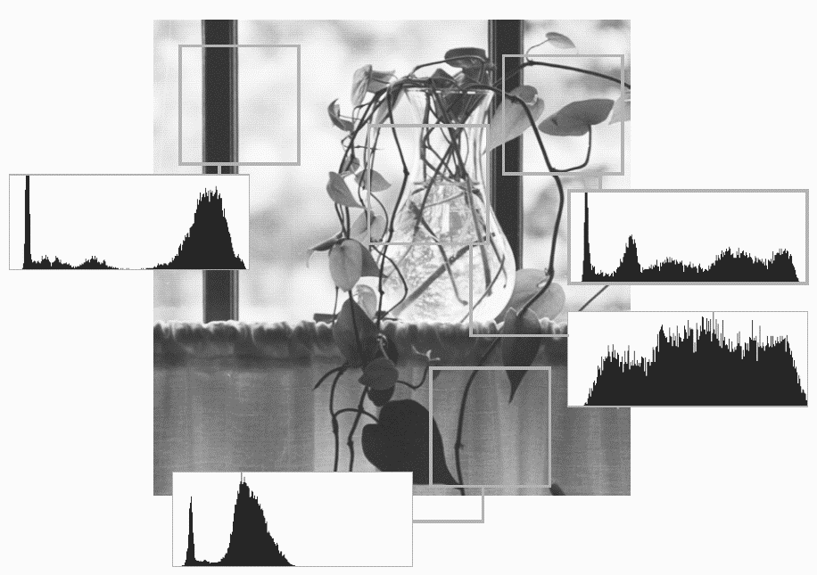
Digital Image Processing
7.1 Background
FIGURE 7.1
A natural image and its local histogram variations.

Slide 3
Digital Image Processing
7.1.1 Image Pyramids
FIGURE 7.2
(a) A pyramidal image structure and (b) system block diagram for creating it.

Slide 4
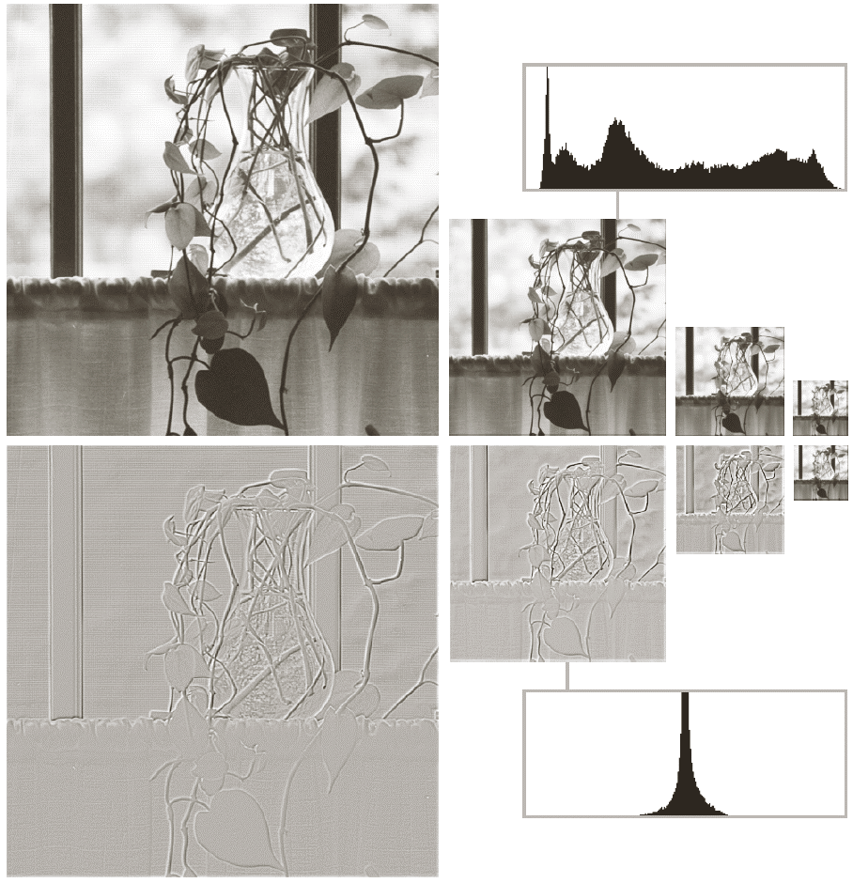
Digital Image Processing
7.1.1 Image Pyramids
FIGURE 7.3
Two image pyramids and their statistics: (a) a Gaussian (approximation) pyramid and (b)a Laplacian (prediction residual) pyramid.

Slide 5
Digital Image Processing
7.1.2 Subband Coding
FIGURE 7.5
(a) A digital filter (b) a unit discrete impulse sequence (c) the impulse response of the filter.

Slide 6
Digital Image Processing
7.1.2 Subband Coding
FIGURE 7.6 Six functionally related filter impulse responses: (a) reference response; (b) sign reversal; (c) and (d) order reversal (differing by the delay introduced); (e) modulation; and (f) order reversal and modulation.

Slide 7
Digital Image Processing
7.1.2 Subband Coding
FIGURE 7.6
(a) A two-band subband coding and decoding system, and (b) its spectrum splitting properties.
f(n): 1-D band-limited discrete-time signal
h: analysis filter
g: synthesis filter

Slide 8
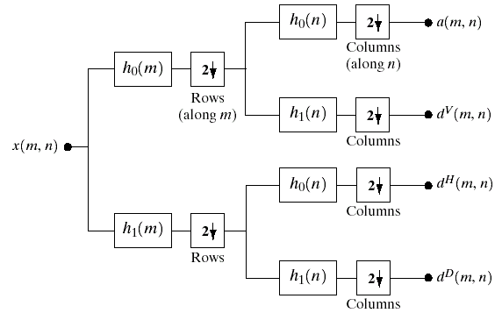
Digital Image Processing
7.1.2 Subband Coding
FIGURE 7.7
A two-dimensional, four band filter bank for subband image coding.

Slide 9
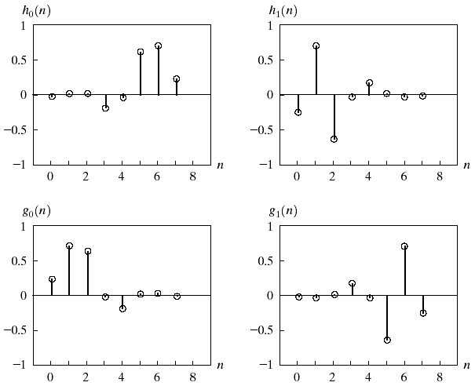
Digital Image Processing
7.1.2 Subband Coding
FIGURE 7.8
The impulse responses of four 8-tap Daubechies orthonormal filters. See Table 7.1 for the value of g₀(n) for 0≤n≤7.

Slide 10
Digital Image Processing
7.1.2 Subband Coding
Table 7.1
Daubechies 8-tap orthonormal filters coefficients for g₀(n)(Daubechies [1992]).

Slide 11
Digital Image Processing
7.1.2 Subband Coding
FIGURE 7.9
A four-band split of the vase in Fig. 7.1 using the subband coding system of Fig. 7.7. The four subbands that result are the (a)approximation, (b)horizontal detail, (c)vertical detail, (d)diagonal detail subbands.
Original image size: 512X512
Each subimage size: 256X256
Aliasing in dH and dV

Slide 12
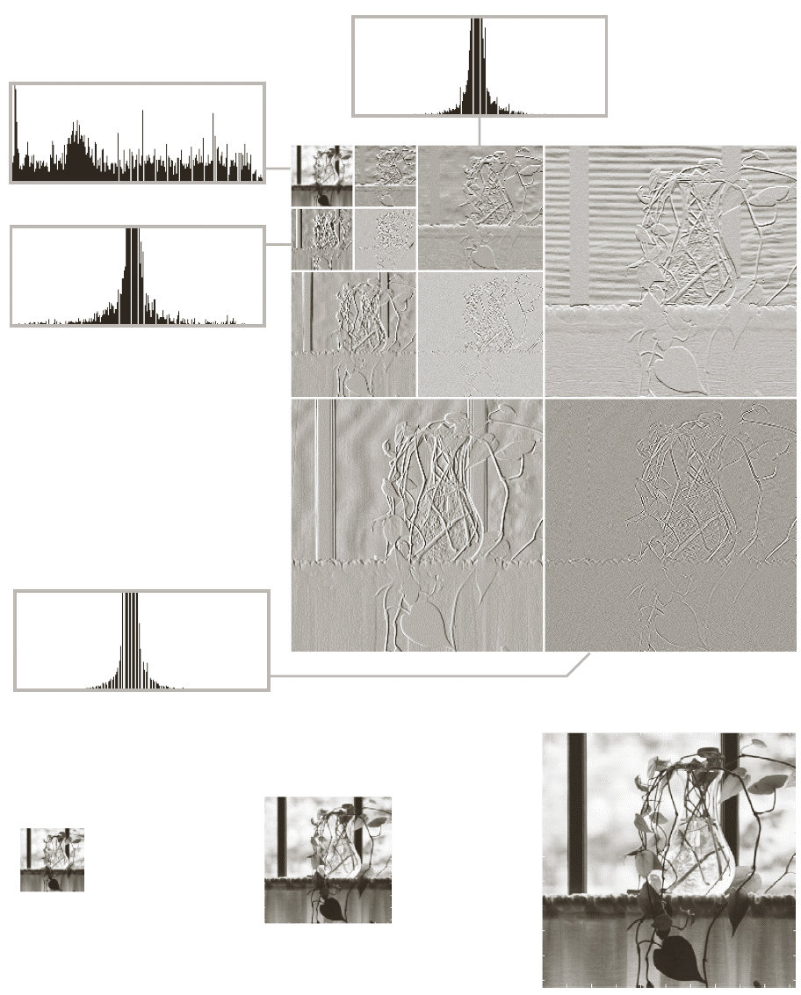
Digital Image Processing
7.1.3 The Haar Tranform
FIGURE 7.10
(a) A discrete wavelet transform using Haar H₂ basis functions. Its local histogram variations are also shown. (b)-(d) Several different approximations (64x64, 128x128, and 256x256) that can be obtained from (a).

Slide 13
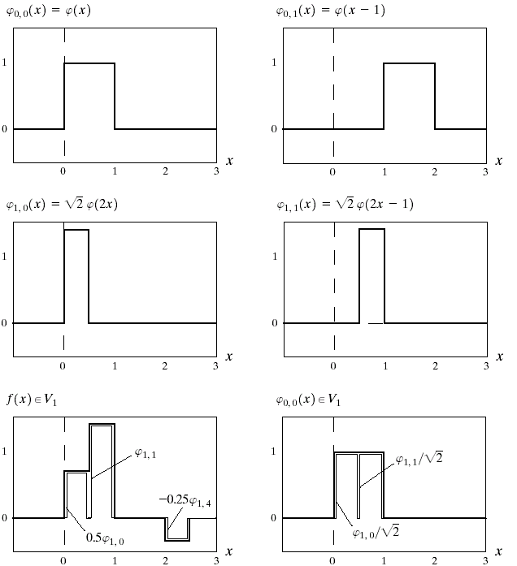
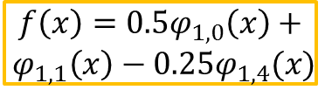
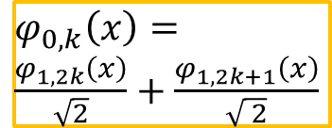
Digital Image Processing
7.2.2 Scaling Function
FIGURE 7.11
Some Haar scaling functions.
$$f\left(x\right)=0.5φ_{1,0}\left(x\right)+$$
$${ φ}_{1,1}\left(x\right)−0.25φ_{1,4}(x)$$
$φ_{0,k}\left(x\right)=\frac{φ_{1,2k}\left(x\right)}{\sqrt{2}}+\frac{φ_{1,2k+1}\left(x\right)}{\sqrt{ 2}}$

Slide 14
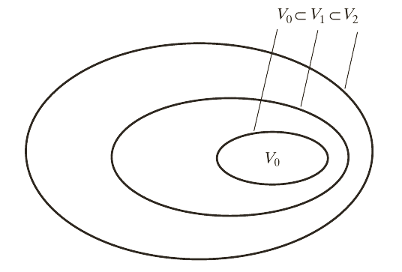
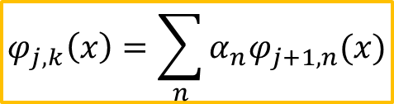
Digital Image Processing
7.2.2 Scaling Function
If f(x) is an element of V₀, it is also an element of V₁
all V₀ expansion function are a part of V₁
V₀ is a subspace
FIGURE 7.12
The nested function spaces spanned by a scaling function.
$$φ_{j,k}\left(x\right)=\sum_{n}{α_{n}φ_{j+1,n}(x)}$$

Slide 15
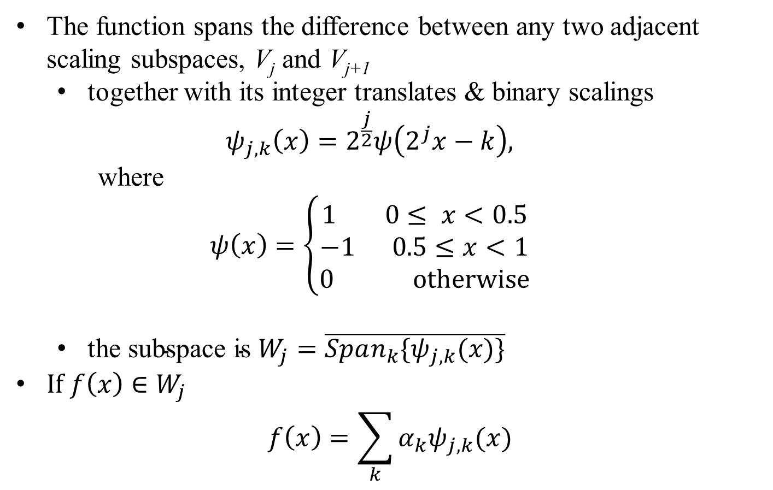
Digital Image Processing
7.2.3 Wavelet Functions
The function spans the difference between any two adjacent scaling subspaces, V_{j} and V_{j+1}
together with its integer translates & binary scalings $ψ_{j,k}\left(x\right)=2^{\frac{j}{2}}ψ\left(2^{j}x−k\right),$
$$\text{where}$$
$$ψ\left(x\right)=\left\{\begin{aligned}1 0≤ x<0.5 \\ −1 0.5≤x<1 \\ 0 otherwise\end{aligned}\right.$$
$\text{the} \text{subspace} \text{is} W_{j}=\overline{Span_{k}\{ψ_{j,k}(x)\}}$
$If f\left(x\right)∈W_{j}$
$$f\left(x\right)=\sum_{k}{α_{k}ψ_{j,k}(x)}$$

Slide 16
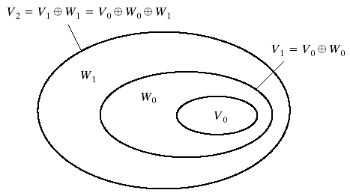
Digital Image Processing
7.2.3 Wavelet Functions
FIGURE 7.13
The relationship between scaling and wavelet function space

Slide 17
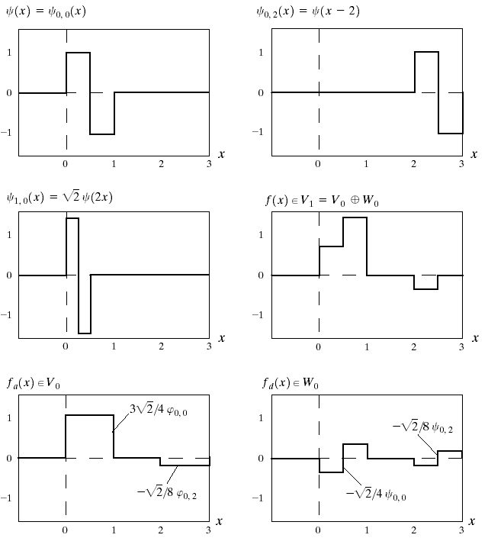
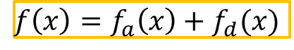
Digital Image Processing
7.3.1 The Wavelet Series Expansions
FIGURE 7.14
Haar wavelet function in W₀ and W₁
$f\left(x\right)=f_{a}\left(x\right)+f_{d}(x)$

Slide 18
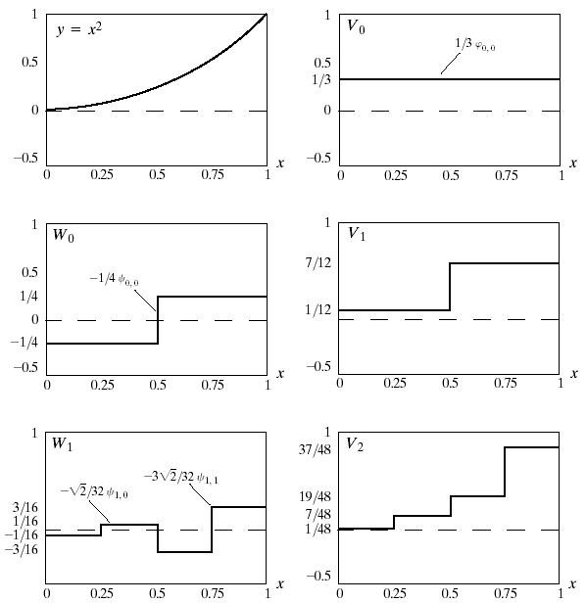
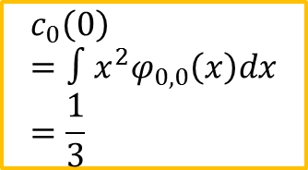
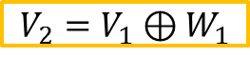
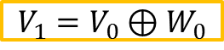
Digital Image Processing
7.3.1 The Wavelet Series Expansions
$$c_{0}\left(0\right)=∫x^{2}φ_{0,0}\left(x\right)dx=\frac{1}{3}$$
FIGURE 7.15
A wavelet series expansion of y=x² using Haar wavelets.
$$V_{1}=V_{0}⊕W_{0}$$
$$V_{2}=V_{1}⊕W_{1}$$

Slide 19
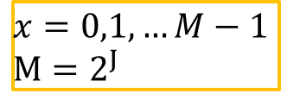
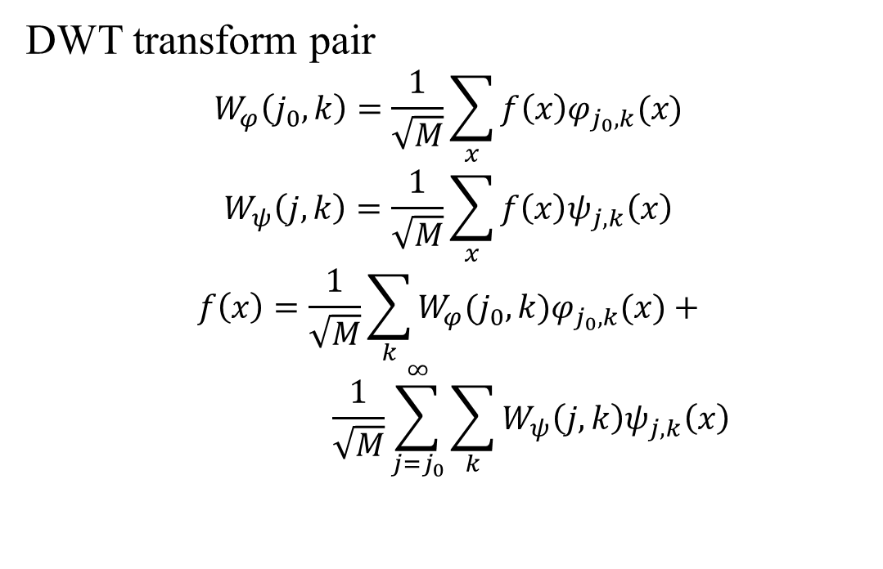
Digital Image Processing
7.3.2 The Discrete Wavelet Transform
DWT transform pair
$$W_{φ}\left(j_{0},k\right)=\frac{1}{\sqrt{M}}\sum_{x}{f\left(x\right)φ_{j_{0},k}(x)}$$
$$W_{ψ}\left(j,k\right)=\frac{1}{\sqrt{M}}\sum_{x}{f\left(x\right)ψ_{j,k}\left(x\right)}$$
$$f\left(x\right)=\frac{1}{\sqrt{M}}\sum_{k}{W_{φ}(j_{0},k)φ_{j_{0},k}(x)}+$$
$$\frac{1}{\sqrt{M}}\sum_{j=j_{0}}^{∞}{\sum_{k}{W_{ψ}\left(j,k\right)ψ_{j,k}\left(x\right)}}$$
$$x=0,1,…M−1$$
$$M=2^{J}$$

Slide 20
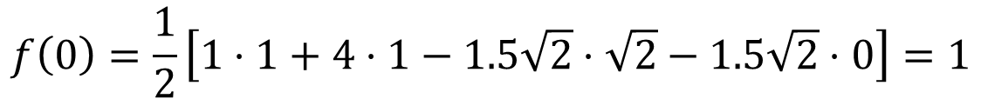
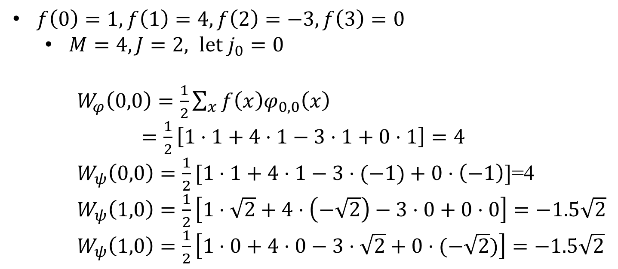
Digital Image Processing
An Example: Compute 1-D DWT
$f\left(0\right)=1, f\left(1\right)=4, f\left(2\right)=−3, f\left(3\right)=0$
$M=4, J=2, let j_{0}=0$
$W_{φ}\left(0,0\right)=\frac{1}{2}\sum_{x}{f\left(x\right)φ_{0,0}\left(x\right)}$
$=\frac{1}{2}\left[1⋅1+4⋅1−3⋅1+0⋅1\right]=4$
$W_{ψ}\left(0,0\right)=\frac{1}{2}[1⋅1+4⋅1−3⋅(−1)+0⋅\left(−1\right)]$=4
$W_{ψ}\left(1,0\right)=\frac{1}{2}\left[1⋅\sqrt{2}+4⋅\left(−\sqrt{2}\right)−3⋅0+0⋅0\right]=−1.5\sqrt{2}$
$W_{ψ}\left(1,0\right)=\frac{1}{2}\left[1⋅0+4⋅0−3⋅\sqrt{2}+0⋅(−\sqrt{2})\right]=−1.5\sqrt{2}$
$$f\left(0\right)=\frac{1}{2}\left[1⋅1+4⋅1−1.5\sqrt{2}⋅\sqrt{2}−1.5\sqrt{2}⋅0\right]=1$$

Slide 21
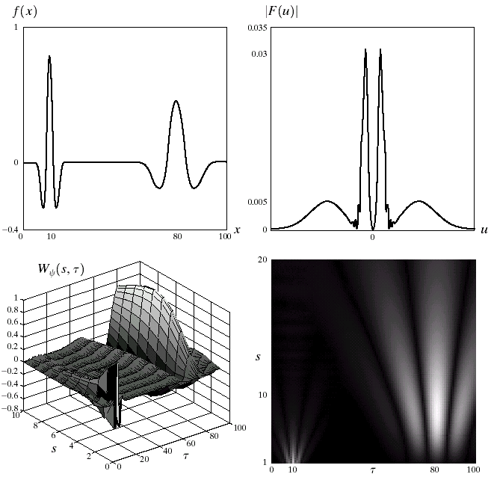
Digital Image Processing
7.3.3 The Continuous Wavelet Transform
FIGURE 7.16
The continuous wavelet transform (c and d) and Fourier spectrum (b) of a continuous 1-D function (a).

Slide 22
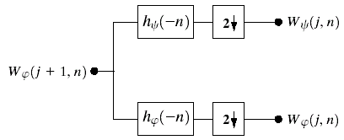
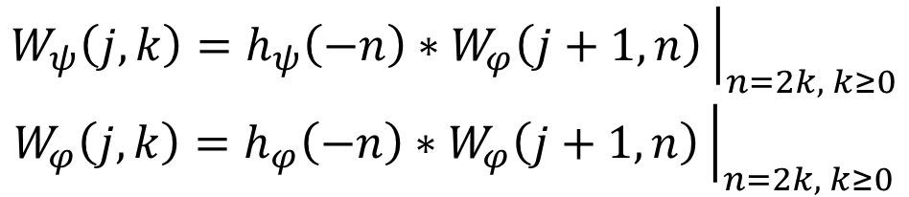
Digital Image Processing
7.4 The Fast Wavelet Transform
$$W_{ψ}\left(j,k\right)=h_{ψ}\left(−n\right)∗W_{φ}\left(j+1,n\right){\left.​\right|}_{n=2k, k≥0}$$
$$W_{φ}\left(j,k\right)=h_{φ}\left(−n\right)∗W_{φ}\left(j+1,n\right){\left.​\right|}_{n=2k, k≥0}$$
FIGURE 7.17
An FWT analysis bank

Slide 23
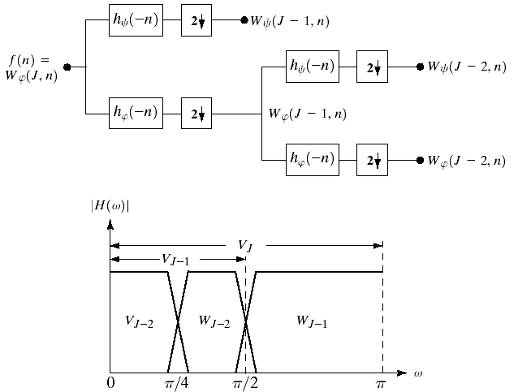
Digital Image Processing
7.4 The Fast Wavelet Transform
FIGURE 7.18
(a) A two-stage or two-scale FWT analysis bank and (b) its frequency splitting characteristics.

Slide 24
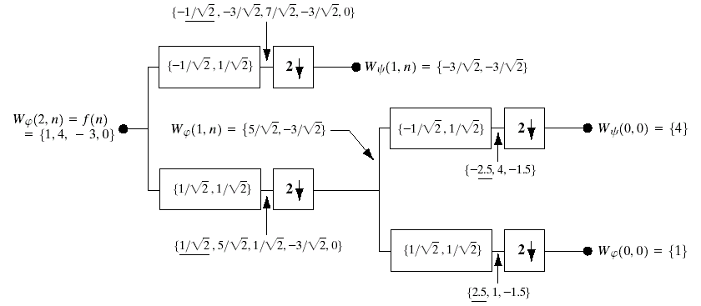
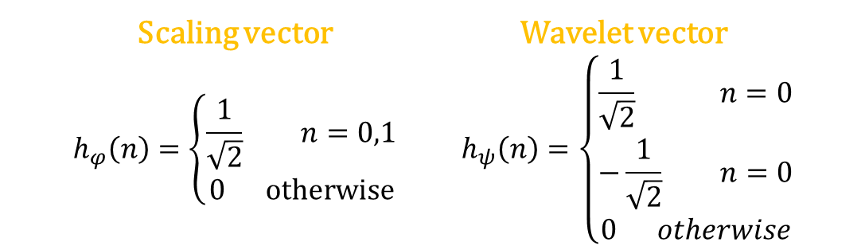
Digital Image Processing
7.4 The Fast Wavelet Transform
Scaling vector Wavelet vector
$$h_{φ}\left(n\right)=\left\{\begin{aligned}\frac{1}{\sqrt{2}} n=0,1 \\ 0 otherwise\end{aligned}\right. h_{ψ}\left(n\right)=\left\{\begin{aligned}\frac{1}{\sqrt{2}} n=0 \\ −\frac{1}{\sqrt{2}} n=0 \\ 0 otherwise\end{aligned}\right.$$
FIGURE 7.19 Computing a two-scale fast wavelet transform of sequence {1,4,-3,0} using Haar scaling and wavelet vectors.

Slide 25
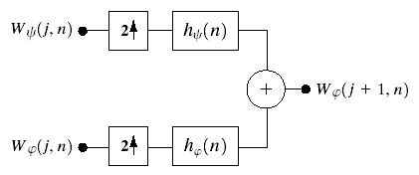
Digital Image Processing
7.4 The Fast Wavelet Transform
FIGURE 7.20
The FWT⁻¹ synthesis filter bank.

Slide 26
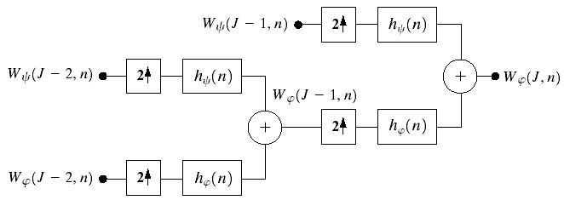
Digital Image Processing
7.4 The Fast Wavelet Transform
FIGURE 7.21 A two-stage or two-scale FWT⁻¹ synthesis bank.

Slide 27
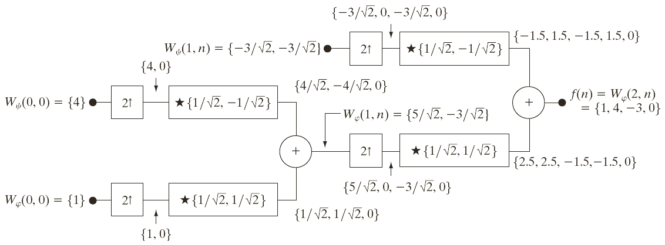
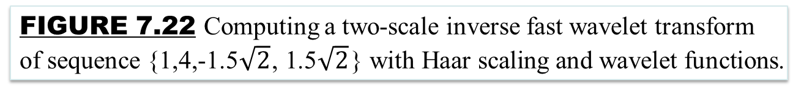
Digital Image Processing
An Example: Computing a 1-D IFWT
FIGURE 7.22 Computing a two-scale inverse fast wavelet transform of sequence {1,4,-1.5$\sqrt{2}$, 1.5$\sqrt{2}$} with Haar scaling and wavelet functions.

Slide 28
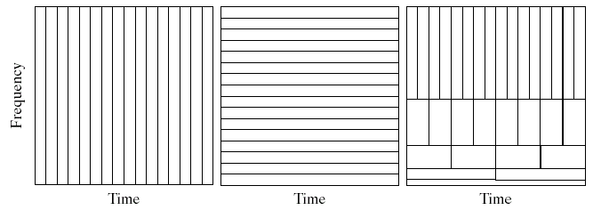
Digital Image Processing
Wavelet Transform vs. Fourier Transform
FIGURE 7.23 Tim-frequency tilings for the basis functions associated with (a) sampled data, (b) the FFT, and (c) the FWT. Note that the horizontal strips of equal height rectangles in (c) represent FWT scales.

Slide 29
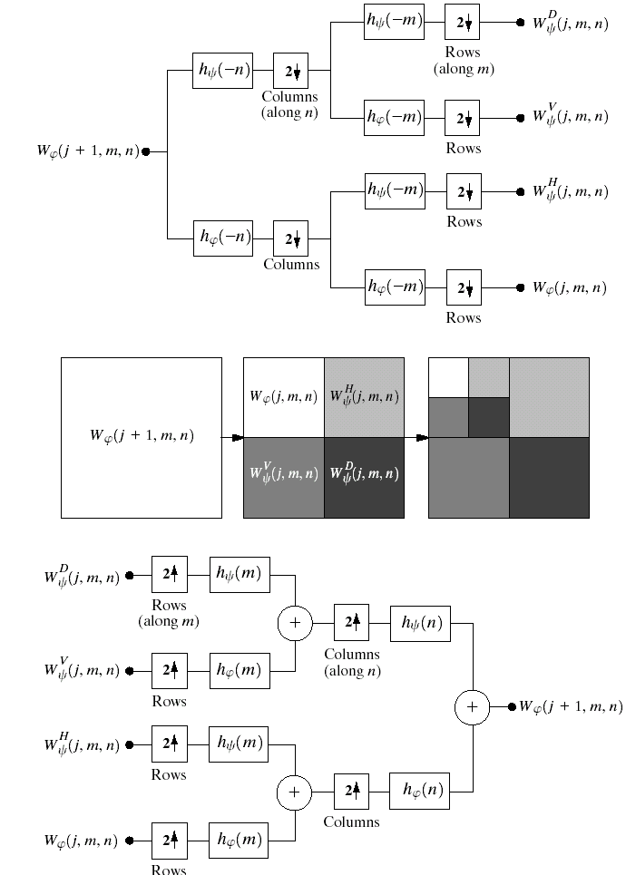
Digital Image Processing
7.5 Wavelet Transforms in Two Dimensions
FIGURE 7.24
Tim-frequency tilings for the basis functions associated with (a) sampled data, (b) the FFT.

Slide 30
Digital Image Processing
7.5 Wavelet Transforms in Two Dimensions
FIGURE 7.24 Tim-frequency tilings for the basis functions associated the FWT. Note that the horizontal strips of equal height rectangles in (c) represent FWT scales.

Slide 31
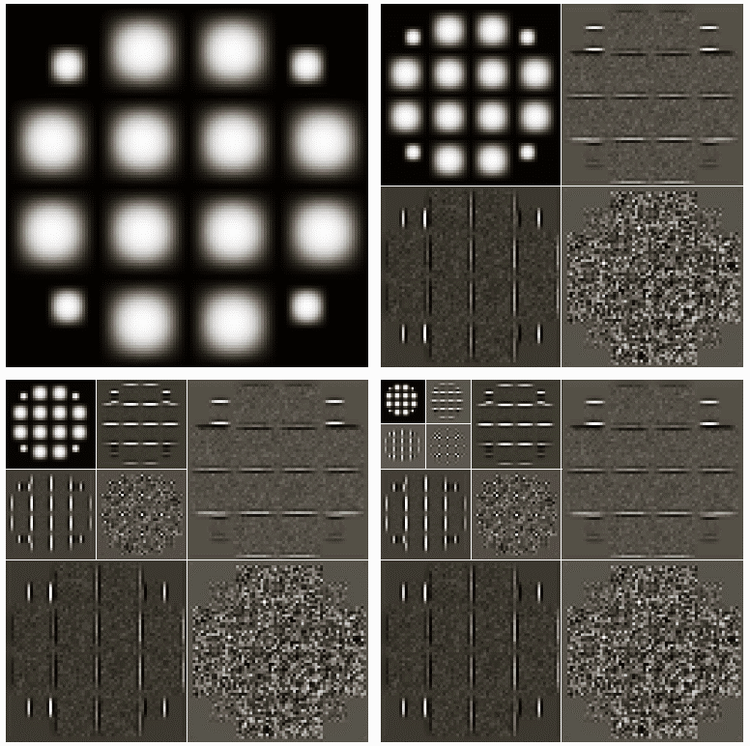
Digital Image Processing
7.5 Wavelet Transforms in Two Dimensions
FIGURE 7.25
Computing a 2-D three-scale FWT: (a) the original image; (b) a one-scale FWT; (c) a two-scale FWT and (d) a three-scale FWT.

Slide 32
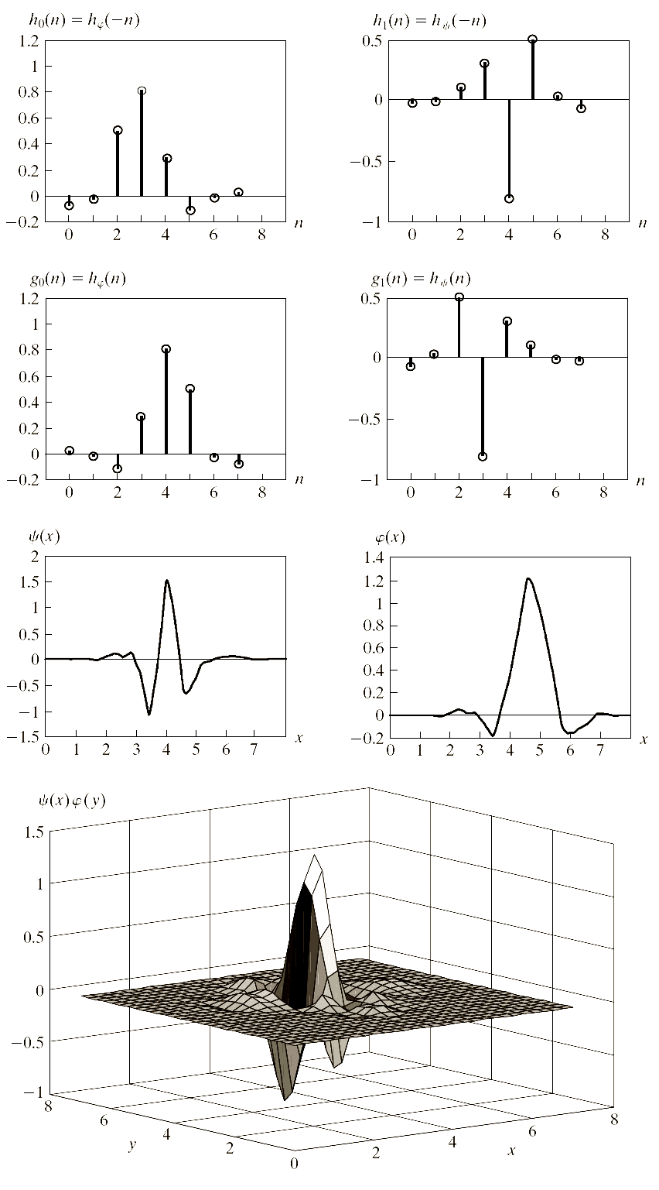
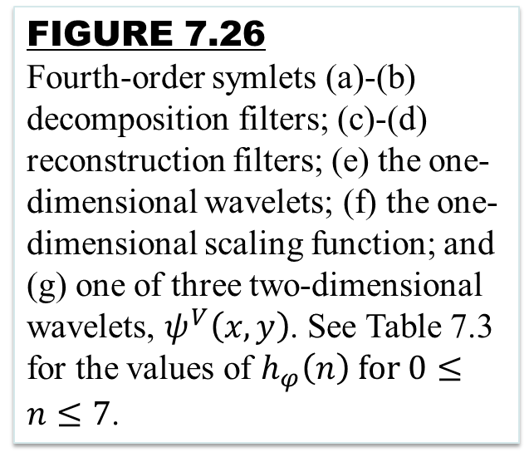
Digital Image Processing
7.5 Wavelet Transforms in Two Dimensions
FIGURE 7.26
Fourth-order symlets (a)-(b) decomposition filters; (c)-(d) reconstruction filters; (e) the one-dimensional wavelets; (f) the one-dimensional scaling function; and (g) one of three two-dimensional wavelets, $ψ^{V}\left(x,y\right)$. See Table 7.3 for the values of $h_{φ}\left(n\right) for 0≤n≤7$.

Slide 33
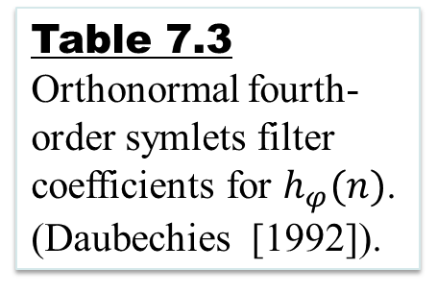
Digital Image Processing
7.5 Wavelet Transforms in Two Dimensions
Table 7.3
Orthonormal fourth-order symlets filter coefficients for $h_{φ}(n)$. (Daubechies [1992]).

Slide 34
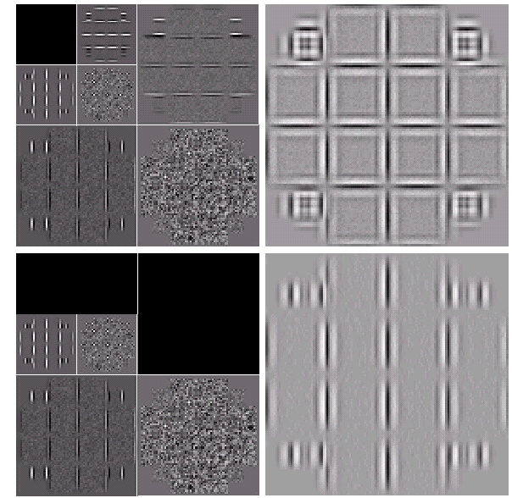
Digital Image Processing
7.5 Wavelet Transforms in Two Dimensions
FIGURE 7.27
Modifying a DWT for edge detection: (a) and (c) two-scale decompositions with selected coefficients deleted; (b) and (d) the corresponding reconstructions.

Slide 35
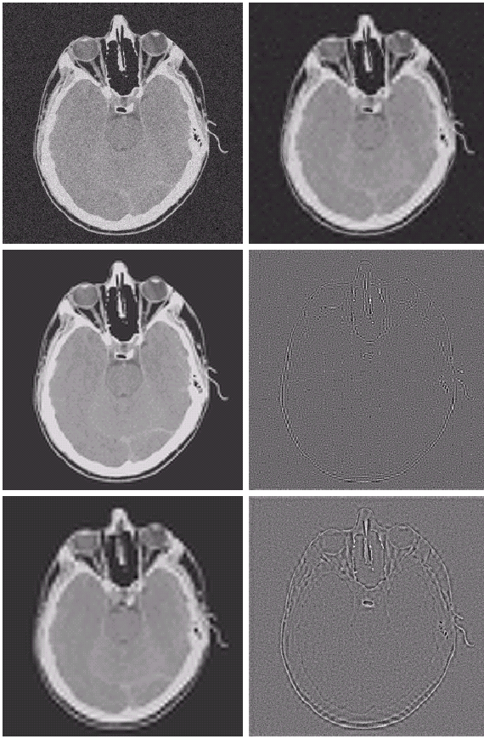
Digital Image Processing
7.5 Wavelet Transforms in Two Dimensions
FIGURE 7.28
Modifying a DWT for noisy removal: (a) a noisy CT of a human head; (b), (c) and (e) various reconstructions after thresholding the detail coefficients; (d) and (f) the information removed during the reconstruction of (c) and (e).

Slide 36
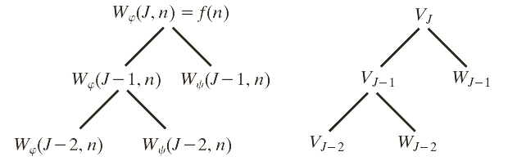
Digital Image Processing
7.6 Wavelet Packets
Wavelet packets: If we want greater control over the partitioning of the time-frequency plane (e.g., smaller bands at the higher frequencies).
generalize the FWT to yield a more flexible decomposition.
FIGURE 7.29
An (a) coefficient tree and (b) analysis tree for the two-scale FWT analysis bank of Fig. 7.18.

Slide 37
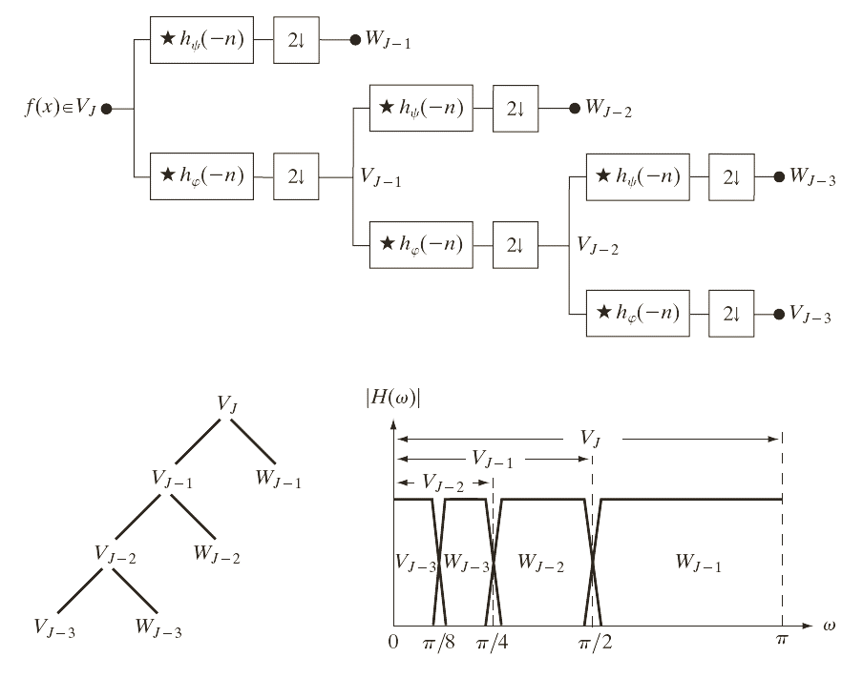
Digital Image Processing
7.6 Wavelet Packets
FIGURE 7.30
A three-scale FWT filter bank: (a) block diagram; (b) decomposition space tree; and (c) spectrum splitting characteristics.

Slide 38
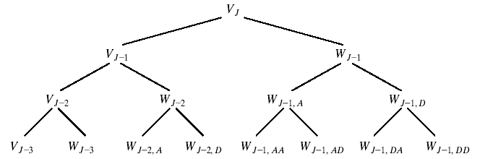
Digital Image Processing
7.6 Wavelet Packets
FIGURE 7.31
A three-scale wavelet packet analysis tree.

Slide 39
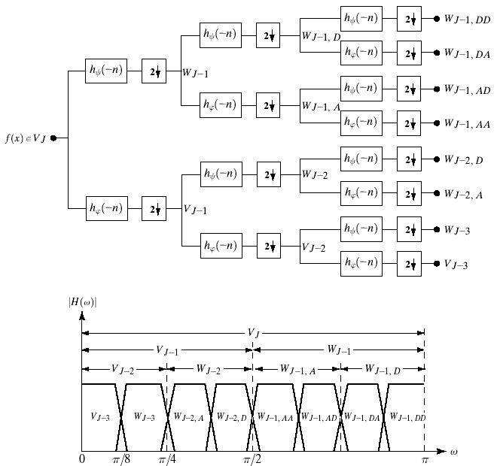
Digital Image Processing
7.6 Wavelet Packets
FIGURE 7.32
The (a) filter bank and (b) spectrum splitting characteristics of a three-scale full wavelet packet analysis tree.

Slide 40
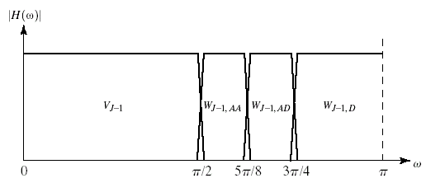
Digital Image Processing
7.6 Wavelet Packets
FIGURE 7.33
The spectrum of the decomposition.

Slide 41
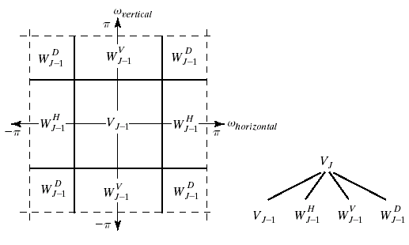
Digital Image Processing
7.6 Wavelet Packets
FIGURE 7.34
The first decomposition of a two-dimensional FWT; (a) the spectrum and (b) the subspace analysis tree.

Slide 42
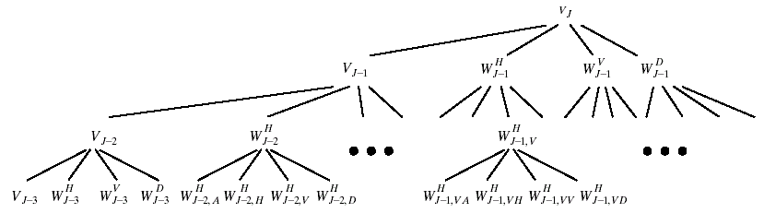
Digital Image Processing
7.6 Wavelet Packets
FIGURE 7.35
A three-scale, full wavelet packet decomposition tree. Only a portion of the tree is provided.

Slide 43
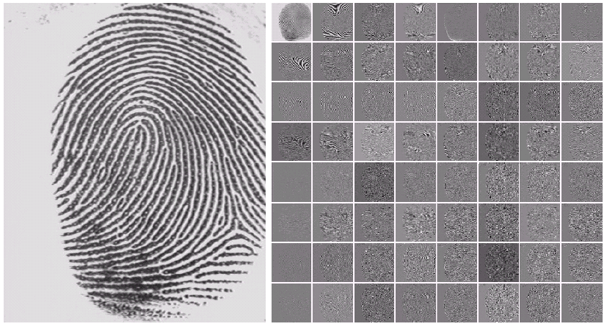
Digital Image Processing
7.6 Wavelet Packets
FIGURE 7.36
(a) A scanned fingerprint and (b) its three-scale, full wavelet packet decomposition.

Slide 44
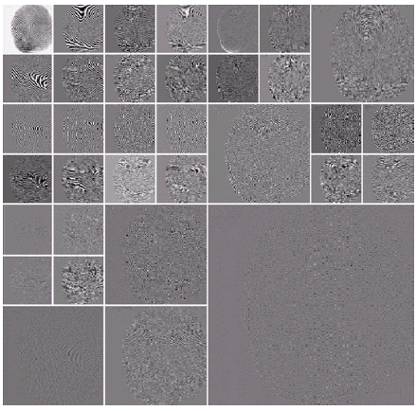
Digital Image Processing
7.6 Wavelet Packets
FIGURE 7.37
An optimal wavelet packet decomposition for the fingerprint of Fig. 7.34(a)

Slide 45
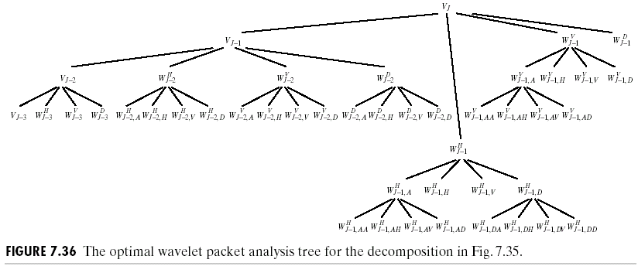
Digital Image Processing
7.6 Wavelet Packets
FIGURE 7.38
The optimal wavelet packet analysis tree for the decomposition in Fig. 7.35.

Slide 46

Digital Image Processing
7.6 Wavelet Packets
FIGURE 7.39
A member of the Cohen-Daubechies-Feauveau biorthogonal wavelet family: (a) and (b) decomposition filter coefficients; (c) and (d) reconstruction filter coefficients; (e)-(h) dual wavelet and scaling functions.

Slide 47










